Slide 1
Demonstration of imaging and recovery steps

Slide 2
Disk imaging

Slide 3
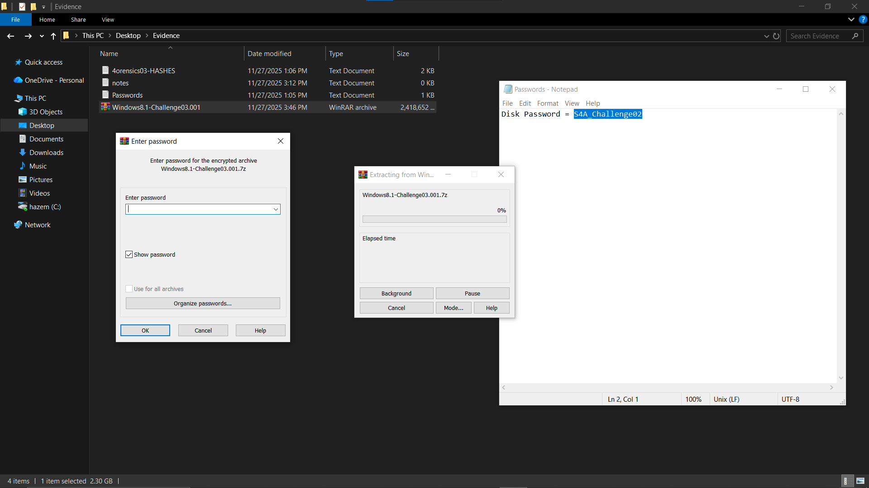
1. Extracting the disk image

Slide 4
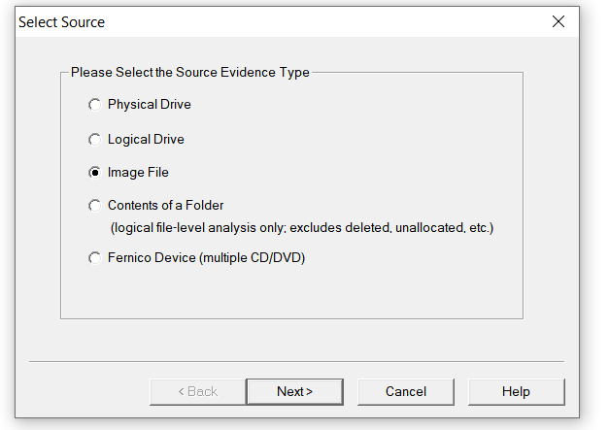
2. making a copy from it

Slide 5
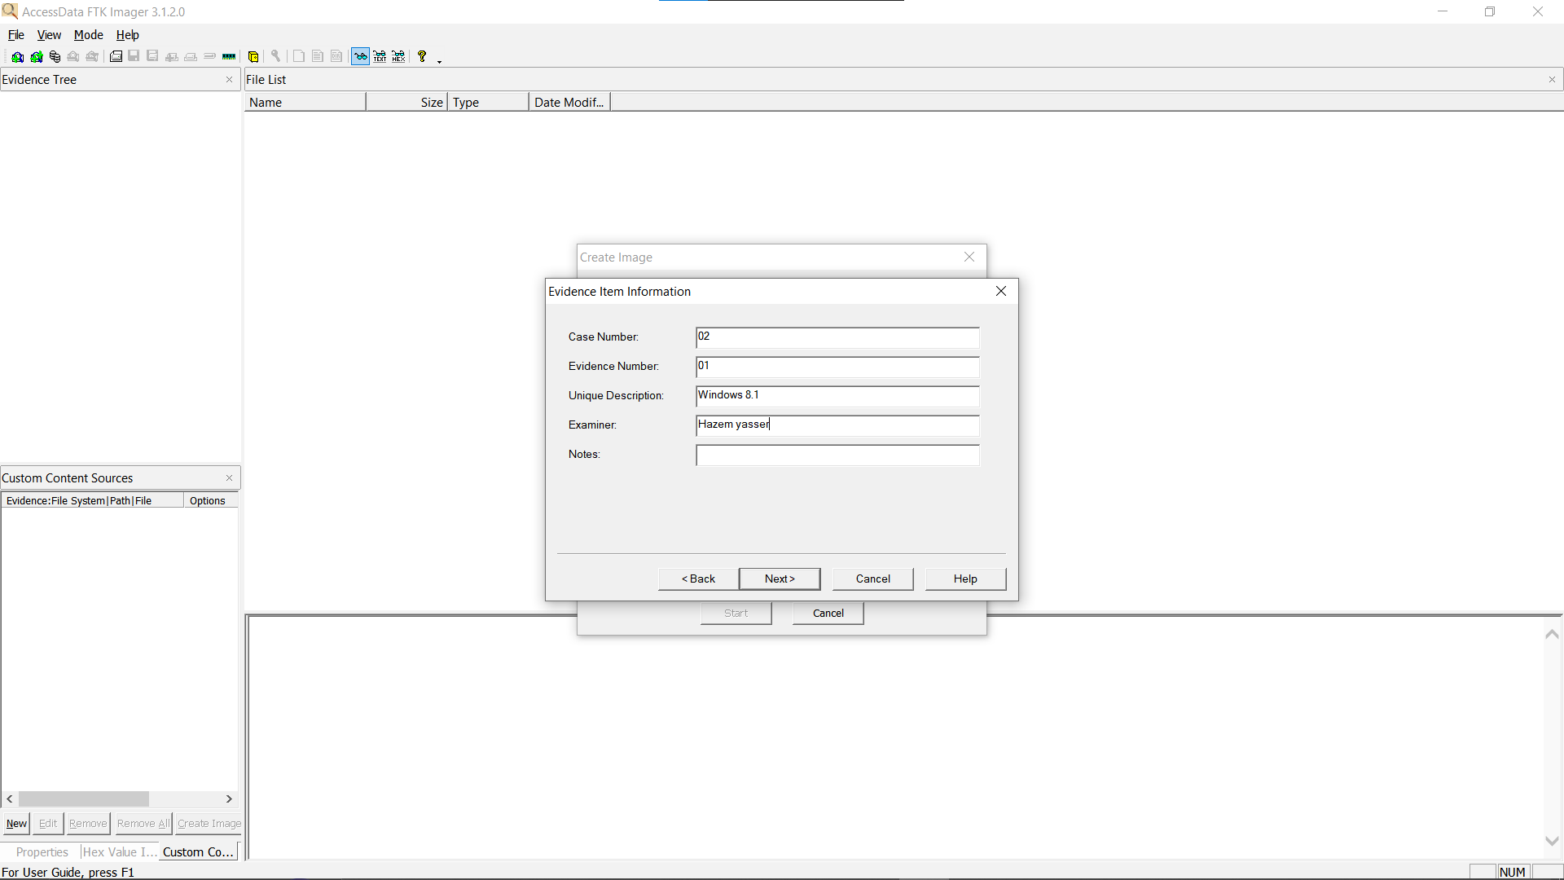
2.1

Slide 6
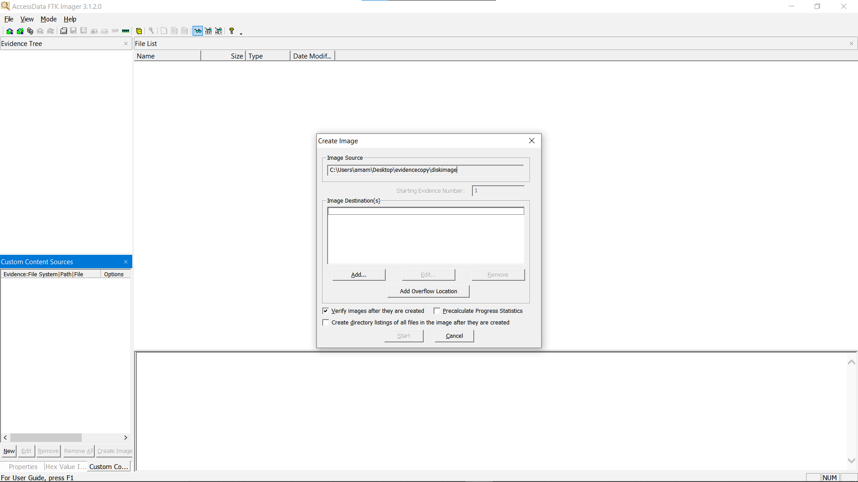
2.2 Setting image destination

Slide 7
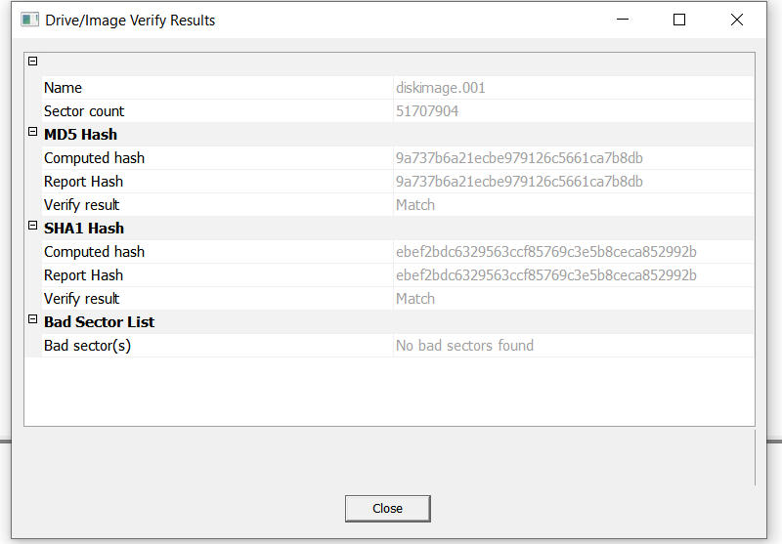
3. Verify Hash

Slide 8
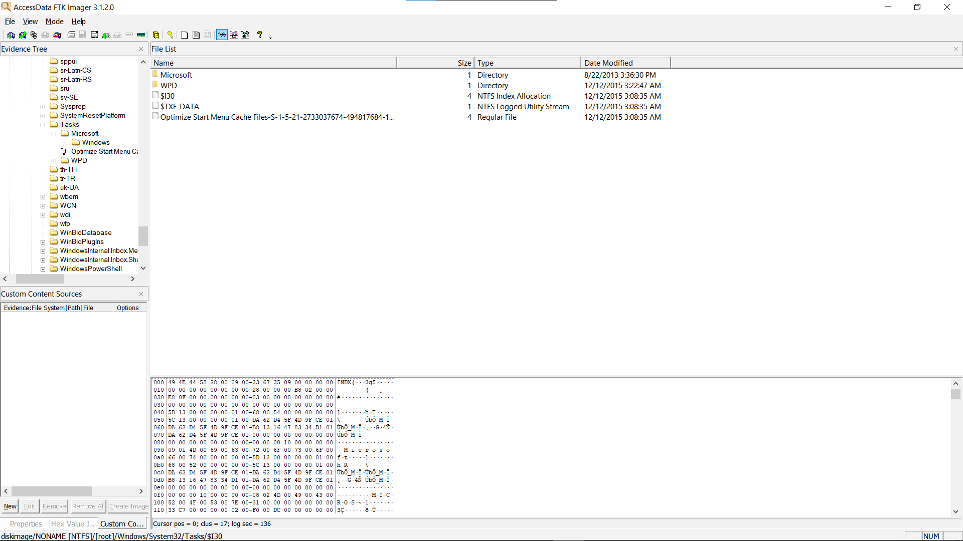
4. Ready for Investigation

Slide 9
Deleted files

Slide 10
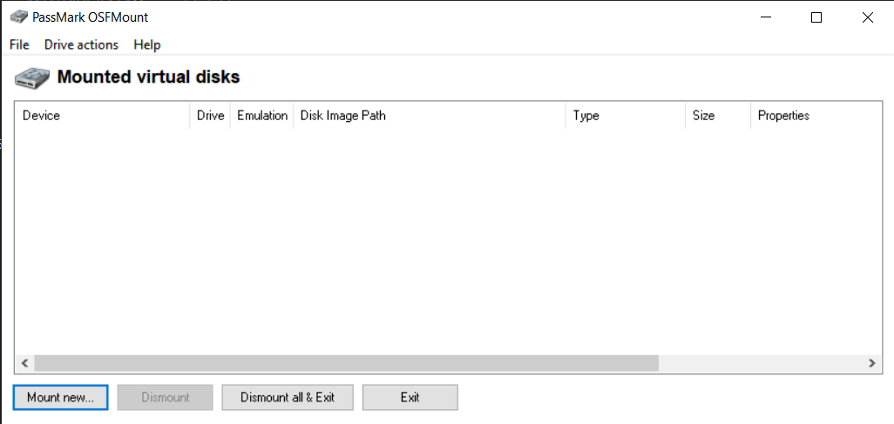
first mounting the disk image

Slide 11
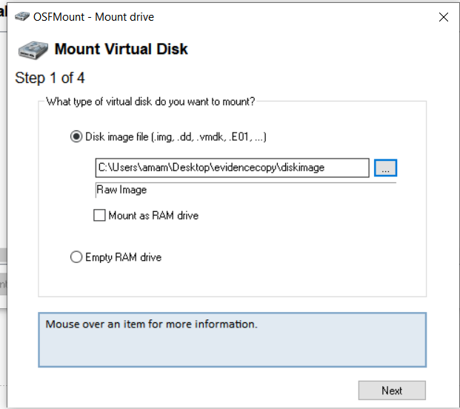

Slide 12
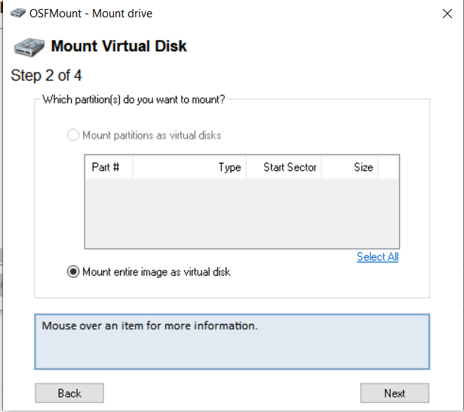

Slide 13
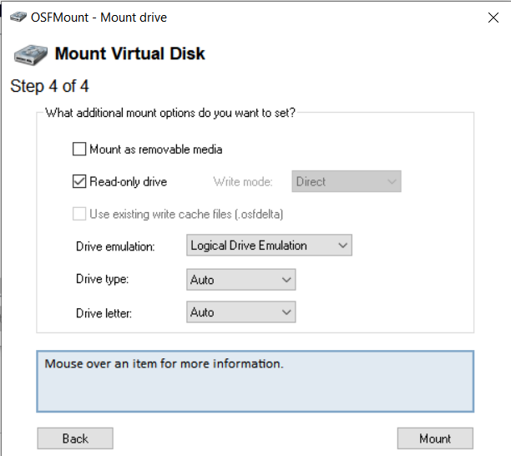

Slide 14
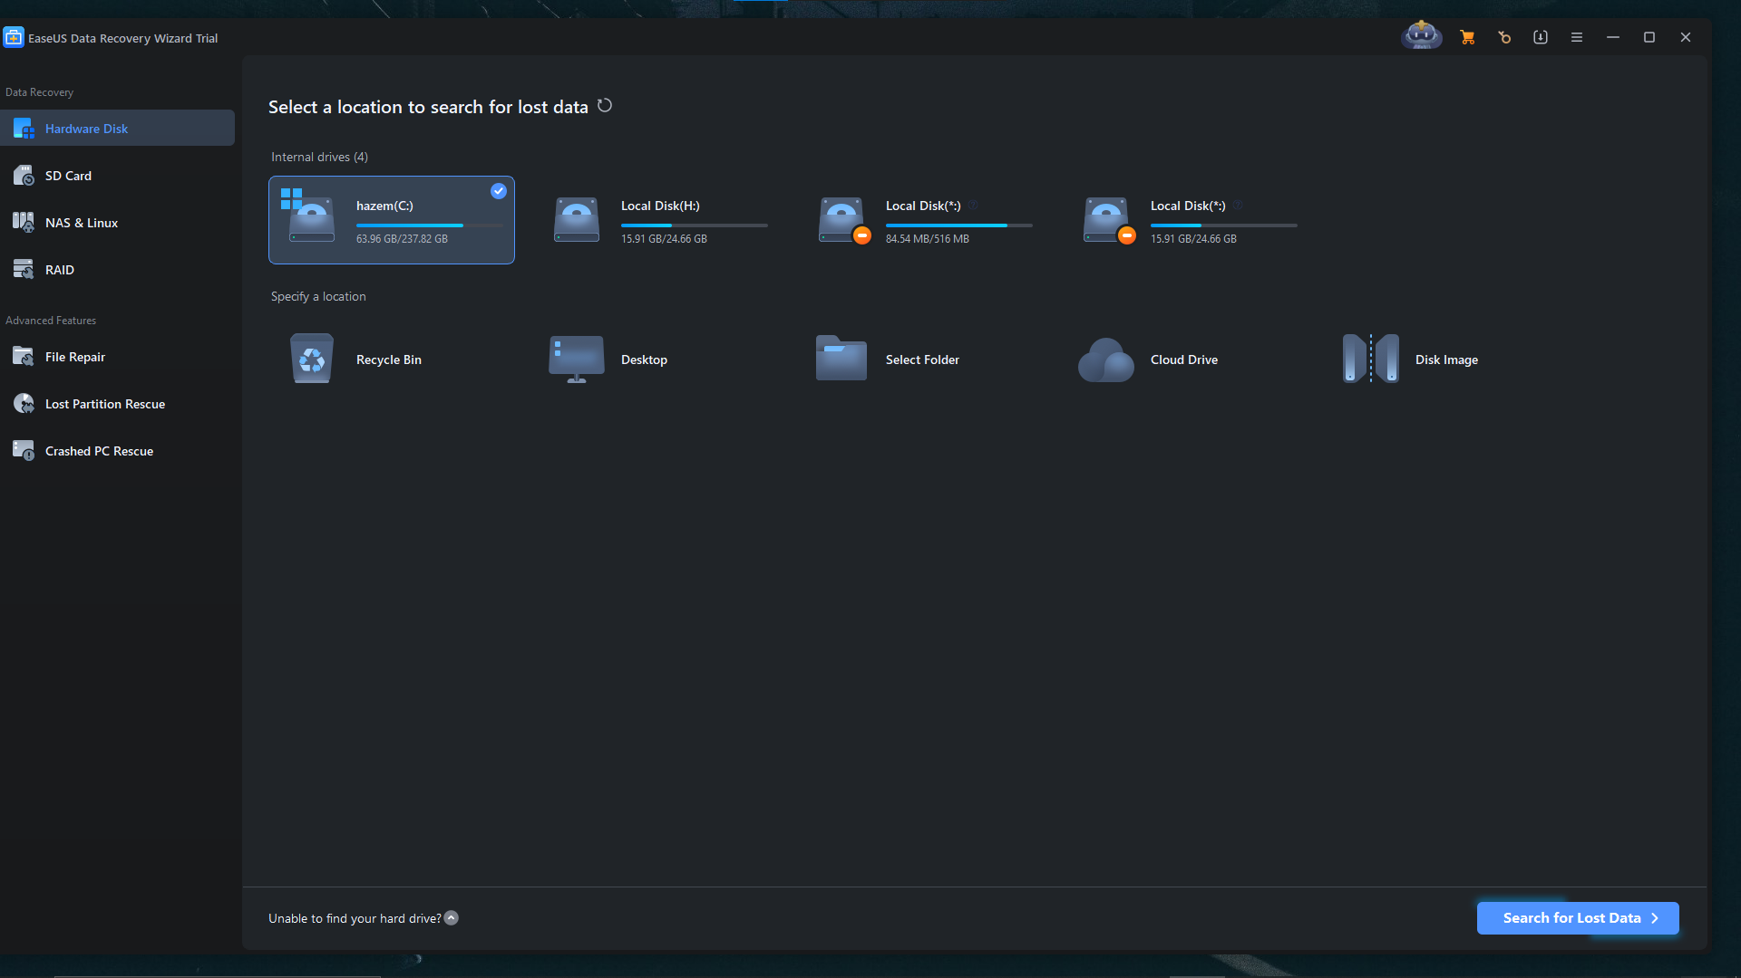
choosing the partition

Slide 15
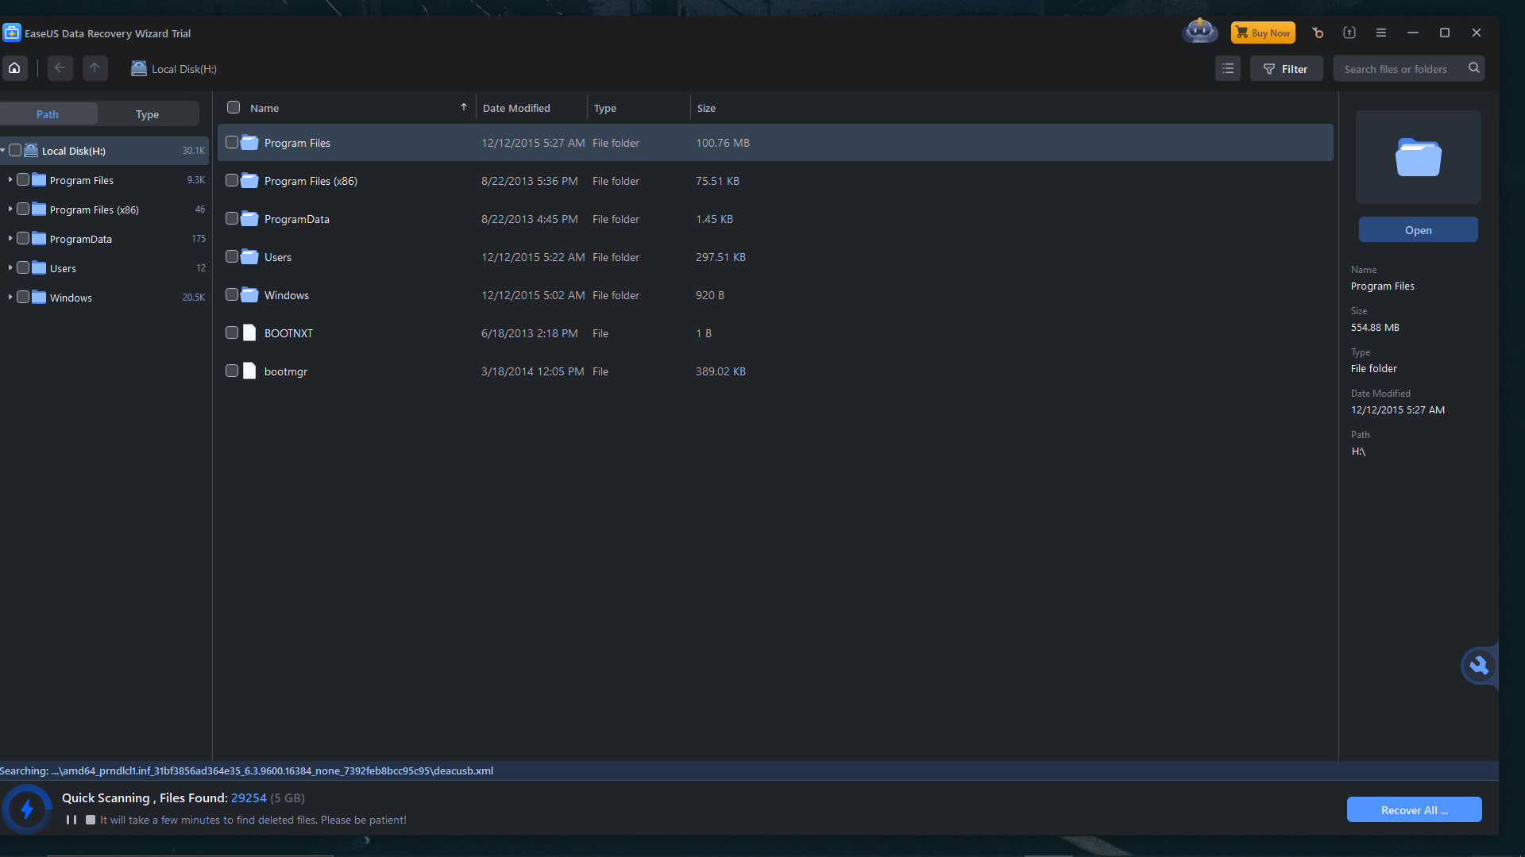

Slide 16
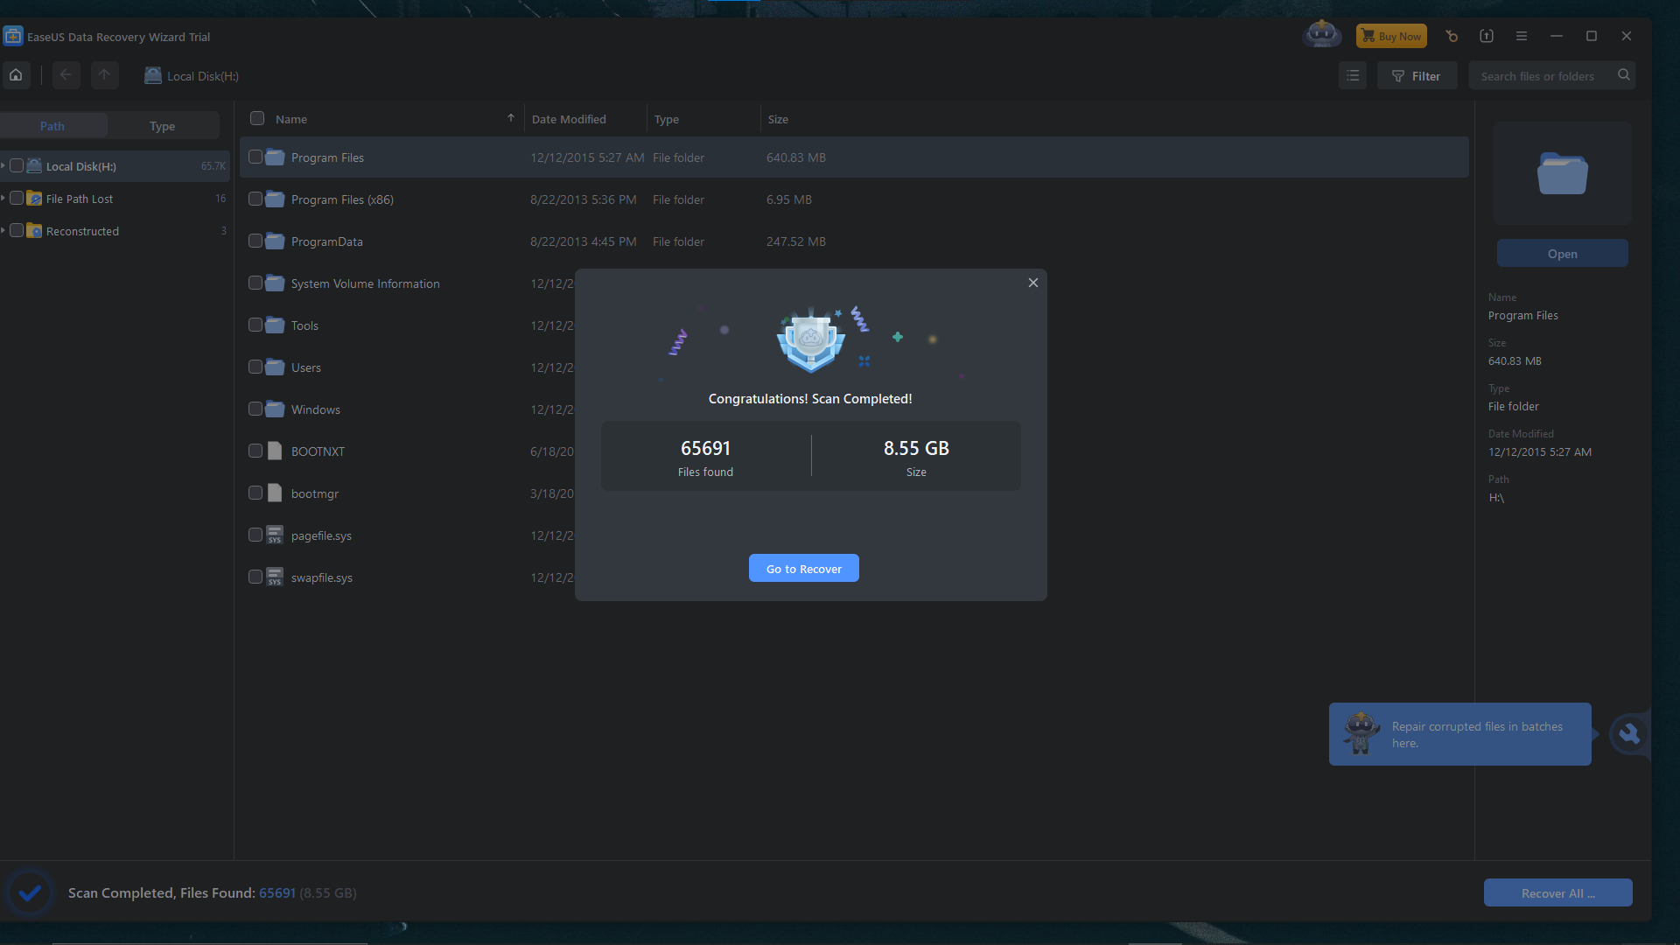
recoved data

Slide 17
